Slide 1
Urine Collection Procedures
U.S. Probation and Pretrial Services
Northern District of Illinois

Slide 2
Introduction
Drug Testing Program Overview
Referral Procedure
Collection Procedure
Shipping Procedure
Common Mistakes/Errors
Supplies

Slide 3
Drug Testing Program Overview
Defendants (Pretrial) and Persons Under Supervision (Probation) may be ordered as a condition of their release to submit to any method of testing required by the US Probation/Pretrial Services Office of the supervising officer for determining whether the defendant or person under supervision (PUS) is using a prohibited substance.
Additionally, a defendant/person under supervision “must not obstruct, attempt to obstruct, or tamper with the efficiency and accuracy of prohibited substance screening or testing.”

Slide 4
Drug Testing Program Overview
Pretrial Services and Probation
Random testing at the direction of the supervising officer
-or-
Enrolled in the COMPLY Program

Slide 5
Comply Program
The Comply program utilizes the offender’s PACTS number. Offenders are to call the designated phone number and enter their PACTS number.
After entering their PACTS number, the recording will notify the offender if they are to submit a drug test. If they are required to submit a drug test, the recording will further explain where and when.
Collection facilities receive an email each evening for the following day to know who is expected to report the next day.

Slide 6
Testing as Directed
Officers may choose not to enroll defendants/PUS in COMPLY, but rather have them test as directed by the supervising officer. In these instances, the supervising officer will notify the designated collection site of the scheduled drug test at least 24 hours in advance authorizing the collection of a urine sample.

Slide 7
Non-compliance/failure to appear
Pretrial Services
Probation
All stalls, failures to appear, non-compliance, and/or suspected tampering must be reported within 24 hours to Pretrial Services’ dedicated failure to appear email:
ILNPTdb_UA_FTA_Notifications@ilnpt.uscourts.gov
All stalls, failures to appear, non-compliance, and/or suspected tampering must be reported within 24 hours to the assigned officer.

Slide 8
Referral procedure

Slide 9
Referral Packets
When a defendant/offender is assigned to a designated collection site, the following signed documents will be provided from the respective agencies to the facility via fax or email:
Pretrial Services
Probation
Release of Information
COMPLY Enrollment Form
Probation Form 45
Urine Collection Instruction Form
Referral Letter (provided in most cases)
Release of Information
Probation Form 45

Slide 10
Sample release of information form BOTH Probation and Pretrial Services

Slide 11
SAMPLE Probation 45 Form BOTH Probation and Pretrial services
Form will include the following information:
Client Identifying Information
(name, address, telephone number, date of birth, PACTS #, assigned Pretrial Services/Probation Officer, picture)
Provider Information
Authorized Services
Instructions to provider

Slide 12
SAMPLE COMPLY ENROLLMENT FORM BOTH Probation and Pretrial services

Slide 13
SAMPLE referral FORM Can be BOTH Probation and Pretrial Services

Slide 14
Referral procedure, continued
A Treatment Services Contract Program Plan, (Prob. 45), must be received by the vendor and must be executed by a U.S. Probation/U.S. Pretrial Services referral agent for services to be rendered.
An amended Program Plan, (Prob. 45), will be prepared by a U.S. Probation/U.S Pretrial Services Officer and executed by a referral agent when changing the services the vendor performs, their frequency, other administrative changes, and upon termination of services.

Slide 15
Collection procedure

Slide 16
Prior to collection
Verify identity of defendants/offenders by means of a valid state driver’s license, state identification, or other acceptable form of photo identification (i.e. government issued identification, identification issued by the Bureau of Prisons or Salvation Army RRC).
If no photo ID is present, contact the defendant/offender’s officer.

Slide 17
Prior to collection
Complete the U.S. Probation OR U.S. Pretrial Services Chain of Custody (CoC) form BEFORE the defendant voids.
Updates Effective March 1, 2023
The new CoC forms are now half pages. Paper is perforated in middle for separating.
There is no longer a carbon copy for the collecting agency to obtain.
Security seal is now client’s initials (previously collector’s initials)

Slide 18
Pre-populated comply chain of custody forms
Each facility will received four (4) emails from Comply at 6:00 p.m. Sunday through Thursday.
List of all pretrial defendants expected to report the following day for testing
List of all probation persons under supervision expected to report the following day for testing
PDF of pre-populated chain of custody forms to print for all expected pretrial defendants
PDF of pre-populated chain of custody forms to print for all expected probation persons under supervision

Slide 19
Printing
Universal printing instructions cannot be provided due to the varying makes and models of printers. The Probation and Pretrial Services Offices recommend the following tips:
----------------------------------------------------------------------------------------------------------------------------------------------
Print the chain of custody forms from the same printer each day to insure consistent printing.
Print the chain of custody PDF on regular white paper to confirm how the chain of custody paper needs to be fed into the printer before printing with the chain of custody paper. You can handwrite “top”, “bottom”, “front”, and “back” on the blank paper before test printing to determine how the paper comes out of your make/model of printer. If still unsure, use the chain of custody paper but only print the first page to confirm the correct paper orientation.
Disable “Print on Both Sides” before printing.
Printing in black and white is acceptable

Slide 20
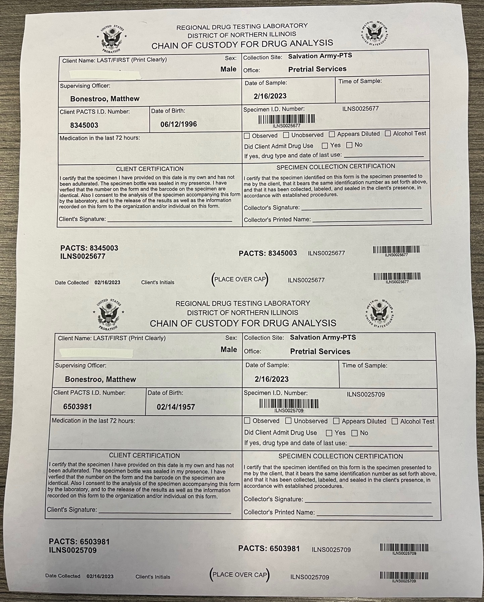
Image of CoC paper as it will be sent to contract service providers
Image of CoC paper after printing

Slide 21
WARNING
DO NOT reuse previously sent chain of custody PDFs. Each email PDF generates new specimen ID numbers and barcodes. Reprinting old PDFs will cause problems with duplicate specimen ID numbers once the sample reaches our lab.

Slide 22
Filling Out the chain of Custody
Chain of custody forms will include the following sections already pre-populated:
Client Name
Sex
Collection Site
Office
Supervising Officer
Date of Sample
PACTS Number
Client Date of Birth
Specimen ID # and Barcodes

Slide 23
Filling Out the chain of Custody
Facilities will be responsible for completing the following (circled in red):
Time of Sample
Medications in last 72 hours
Observed/Unobserved
Client Admit to Drug Use
Client Certification
Specimen Collection Certification
Client Initials on Barcode
Place security seal over lid of collected sample and affix label with PACTS No. and Specimen ID No. to side of bottle (circled in yellow)

Slide 24
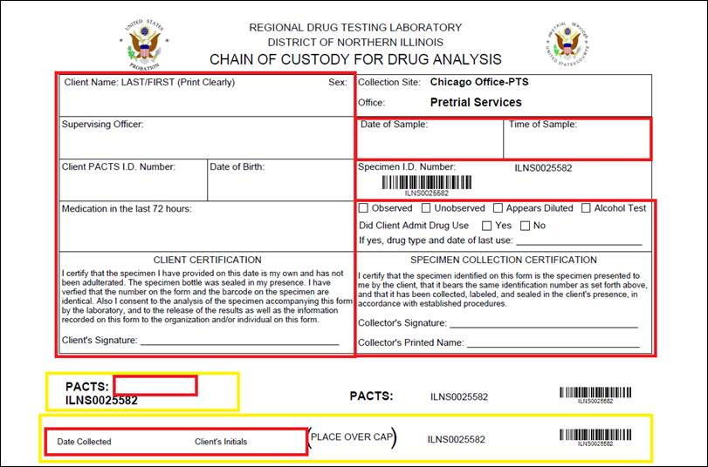
Barcode forms
These forms can be used in the event a defendant/person under supervision reports to your facility on short notice and a pre-populated form was not generated the night before. In these instances, the collector will need to hand write all other sections of the form. These chain of custody forms should only be used when a client is present at your facility, collection is authorized, and a pre-populated form is not available.
Confirm which agency’s form you are using before filling it out.

Slide 25
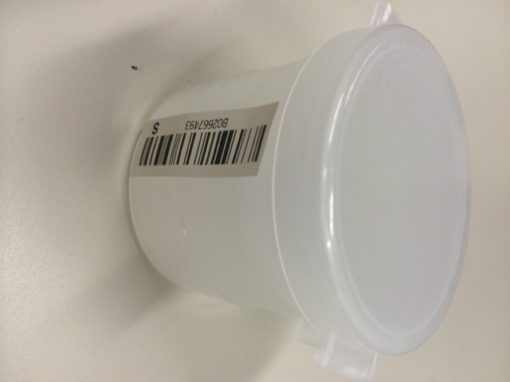
Chain of Custody
Prior to collection, place one bar code sticker from the chain of custody on the collection cup

Slide 26
Universal Precautions
The use of Protective Barriers is strongly recommended for the collector before any collection is attempted.
Examples of barriers include;
Gloves
Masks
Eyewear
Gowns.
Face Shields

Slide 27
Prepping for collection
Prior to collection, defendant/PUS must:
Remove any jackets or coats and roll up long sleeve to their elbows before entering the collection room
Leave purses or any other carried items outside the collection room or in control of the specimen collector
Rinse and thoroughly dry hands prior to voiding

Slide 28
Secure Collection Area
To the best extent possible, provide a lavatory only for collecting urine specimens that is not used by staff or others not providing a urine specimen.

Slide 29
Collecting the Sample
Directly observe the donor voiding into a specimen collection container.
Collectors observing the voiding process must be the same sex as the defendant/offender providing the specimen.
Collect a minimum of 30 milliliters of urine.
Observe and document any indication of specimen dilution and/or adulteration, or any unusual collection events or discrepancies.

Slide 30
Unobserved collections
Only when the defendant/offender and the collector are not of the same sex.
Clearly document on the Chain of Custody Form that collection was unobserved.
Place a blue or green colored toilet bowl cleaner or coloring agent in the toilet bowl.
Secure any sources of water in the collection area.
Remove and/or secure any agents such as soaps, cleaners and deodorizers.
Follow all general collection procedures.

Slide 31
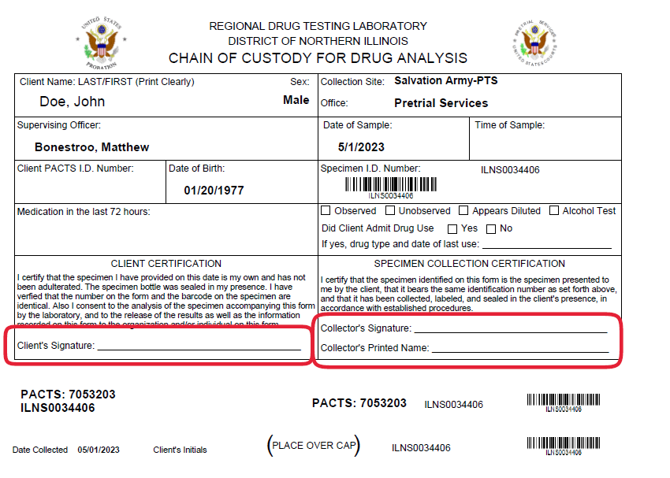
Following collection
The collector AND donor must sign the chain of custody form AFTER the sample is collected.
Review temperature of sample, especially unobserved collections. The temperature of the sample should be measured within 4 minutes of collection and should be within a range of 90 – 100 degrees. Document any discrepancies.
Place the sealed sample in the inner pocket of the plastic bag containing the absorption sheet. (sealing instructions on next page)
Place the chain of custody form in the outside pocket.
Seal bag.

Slide 32
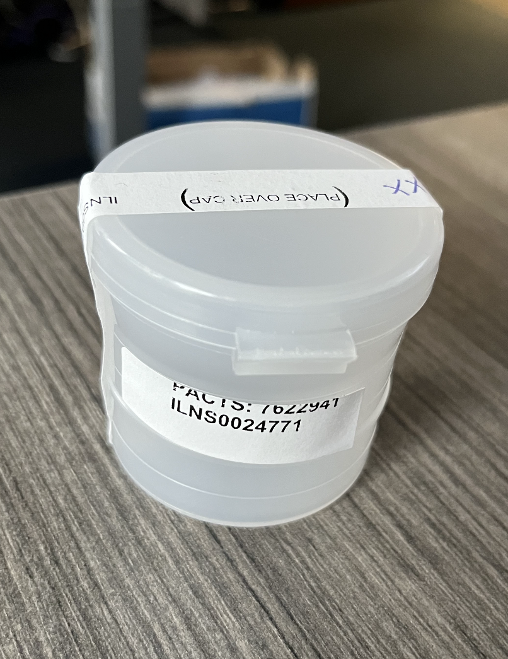
Following collection
Secure top of collection cup. (Collector must ensure the top is sealed tightly and is not leaking)
Place the signed security seal across the top of the collection cup and down both sides. Do not cover bar code or name with the seal.
Only use one security seal to secure collection cup.

Slide 33
Storing samples
All samples collected must be refrigerated if not shipped the same day.
1
Refrigerated samples must be stored in a secure area or in a locked refrigerator with access limited only to collectors or other authorized personnel.
2
Samples must be sent to the U.S. Pretrial Services Office within 48 hours of collection.
3

Slide 34
Shipping procedure

Slide 35
Packing samples for shipment
Place samples into a U.S. Postal Service (USPS) bag and then place into a USPS cardboard box.
1
Affix Merchandise Return shipping label to USPS box and write your return address on upper left corner.
2
Ensure bags/boxes are sealed and that the shipping label is securely attached to the box.
3
Do not overfill any bags/boxes to ensure safe shipment (Recommended 8-10 samples max. per bag, 2 bags max. per box).
4

Slide 36
Shipping procedure
All shipping supplies are provided by the U.S Probation Office.
Only use the provided USPS boxes, bags, and Merchandise Return shipping labels to ship specimens (do not make copies of shipping labels).
Schedule a pickup with USPS, take samples directly to the post office, or have samples ready and include in your daily mail.
Samples must remain in a secured area until placed in the custody of an approved delivery service or courier.

Slide 37
Common mistakes and errors

Slide 38
Reasons a sample cannot be tested
Broken/Missing security seal
Improperly filled out CoC
No defendant/offender signature
No collector signature
Non-matching bar codes on urine cup and chain of custody form
Excessive leakage resulting in insufficient volume of sample, (less than 30ml)

Slide 39
Supplies

Slide 40
Ordering
Chain of Custody Forms (Pretrial and Probation), Specimen Bags, Flip Top Containers, and Merchandise Return Labels are provided by the U.S. Probation Office
Use the Specimen Supply Collection order from provided by the U.S. Probation to request supplies.
Shipping boxes and bags are ordered online or telephone via U.S. Postal Service (USPS).

Slide 41
Ordering
Review inventory monthly and maintain a 90-day supply on all collection/shipping supplies.
Email all supply requests to:
INTAKE_BOP@ilnp.uscourts.gov

Slide 42
Creating a usps account
1. Go to www.USPS.com
2. In the top right hand corner of the main page, click Register/Sign In
3. A separate window will open, go to New to USPS.com? and select Sign Up Now
4. Language preference will default to English
5. Create a username
6. Enter Security Information which includes *Pick a Password and *Pick Two Security Questions
7. Select My account type is a Business account
8. Next, enter in contact information (Name, phone number, email address)
9. Find my address by…address or zip code. When prompted, enter your facility’s full address or zip code so that the best deliverable option for your facility is entered. When your agency’s information has been filled in, hit continue to create the account.
Should you have any questions please feel free to contact Wendy Gingell at 312-408-7797 or email wendy_gingell@ilnp.uscourts.gov

Slide 43
Ordering usps supplies
On the USPS Homepage (www.usps.com), click on the Postal Store tab
Scroll down to the Shipping Supplies section and click on Shipping Supplies
On the left hand side, select “Free Shipping Supplies”
The following free shipping supplies are recommended
Priority Mail Tyvek Envelope (11-5/8” x 15-1/8”)
Priority Mail Padded Flat Rate Envelope (9-1/2” x 12-1/2”)
Priority Mail Regional Rate Box- B1 (12” x 10-1/4” x 5”)
Priority Mail Regional Rate Box- A1 (10” x 7” x 4-3/4”)
Select the needed shipping supplies and the quantity of supplies. Supplies come in varying quantities
Click “Add to Cart”
Once all supplies have been ordered, click Checkout and select your agency’s address that was entered upon creating the account
The final page will display your ordered supplies. If the order is complete, click “Place my Order”. Supplies ship within 3-5 business days with the exception of Holidays where an additional 1-2 days will be needed to complete orders. Please note that shipping times may be greater during holidays.
For large supply orders, call USPS at 1-800-610-8734. The first time you call, you will be prompted to create an account that is associated with your telephone number, once an account is created, you can order your needed supplies based off their item name (Priority Mail Tyvek Envelope, Priority Mail Reginal Rate Box-B1, etc.)

Slide 44
Contact information
Pretrial Services
Probation
Drug Labratory
219 South Dearborn Street
Suite 15-100
Chicago, IL 60604
Main Number: 312-435-5793
Patrick May, Lab Supervisor
312-246-2273
Patrick_May@ilnpt.uscourts.gov
230 South Dearborn Street
Suite 3400
Chicago, IL 60604
Main Number: 312-435-5700
219 South Dearborn Street
Suite 15-100
Chicago, IL 60604
Ernesto De La Rosa, Lab Technician
312-408-7760

